Slide 1

VENKATRAMA PHANI KUMAR S Asst. Professor, Department of CSE VFSTR University
Process Synchronization
UNIT-II

Slide 2

Topics to be Covered
Background
The Critical-Section Problem
Peterson’s Solution
Synchronization Hardware
Mutex Locks
Semaphores
Classic Problems of Synchronization
Monitors
Synchronization Examples
Alternative Approaches

Slide 3
Objectives
To present the concept of process synchronization.
To introduce the critical-section problem, whose solutions can be used to ensure the consistency of shared data
To present both software and hardware solutions of the critical-section problem
To examine several classical process-synchronization problems
To explore several tools that are used to solve process synchronization problems

Slide 4
Background
Processes can execute concurrently
May be interrupted at any time, partially completing execution
Concurrent access to shared data may result in data inconsistency.
Maintaining data consistency requires mechanisms to ensure the orderly execution of cooperating processes

Slide 5
Background
Illustration of the problem:
Suppose that we wanted to provide a solution to the consumer-producer problem that fills all the buffers.
We can do so by having an integer counter that keeps track of the number of full buffers.
Initially, counter is set to 0. It is incremented by the producer after it produces a new buffer and is decremented by the consumer after it consumes a buffer.

Slide 6
Producer Process
Illustration- Example
Consumer Process
while (true) { /* produce an item in next produced */
while (counter == BUFFER_SIZE) ;
/* do nothing */
buffer[in] = next_produced;
in = (in + 1) % BUFFER_SIZE;
counter++;
}
while (true) {
while (counter == 0)
; /* do nothing */
next_consumed = buffer[out];
out = (out + 1) % BUFFER_SIZE;
counter--;
/* consume the item in next consumed */
}

Slide 7
Race Condition
counter++ could be implemented as register1 = counter register1 = register1 + 1 counter = register1
counter-- could be implemented as register2 = counter register2 = register2 - 1 counter = register2
Consider this execution interleaving with “count = 5” initially:
S0: producer execute register1 = counter {register1 = 5} S1: producer execute register1 = register1 + 1 {register1 = 6} S2: consumer execute register2 = counter {register2 = 5} S3: consumer execute register2 = register2 – 1 {register2 = 4} S4: producer execute counter = register1 {counter = 6 } S5: consumer execute counter = register2 {counter = 4 }

Slide 8
Critical Section
Consider system of n processes {p₀, p₁, … p_{n-1}}
Each process has critical section segment of code
Process may be changing common variables, updating table, writing file, etc
When one process in critical section, no other may be in its critical section
Critical section problem is to design protocol to solve this
Each process must ask permission to enter critical section in entry section, may follow critical section with exit section, then remainder section

Slide 9
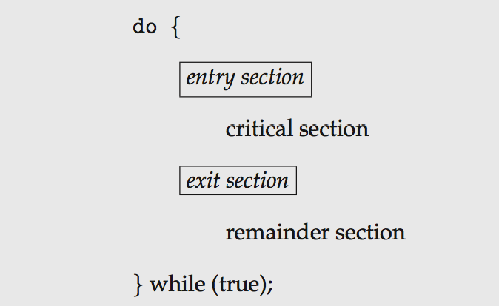
Critical Section
General structure of process P_{i}
Algorithm of process P_{i}
do {
while (turn == j);
turn = j;
critical section
remainder section
} while (true);

Slide 10
Solution to Critical-Section Problem
Mutual Exclusion - If process P_{i} is executing in its critical section, then no other processes can be executing in their critical sections
Progress - If no process is executing in its critical section and there exist some processes that wish to enter their critical section, then the selection of the processes that will enter the critical section next cannot be postponed indefinitely

Slide 11
Solution to Critical-Section Problem
Bounded Waiting - A bound must exist on the number of times that other processes are allowed to enter their critical sections after a process has made a request to enter its critical section and before that request is granted
Assume that each process executes at a nonzero speed
No assumption concerning relative speed of the n processes

Slide 12
Peterson’s Solution
Good algorithmic description of solving the problem
Two process solution
load and store are atomic instructions;
that is, cannot be interrupted
The two processes share two variables:
int turn;
Boolean flag[2]
The variable turn indicates whose turn it is to enter the critical section
The flag array is used to indicate if a process is ready to enter the critical section. flag[i] = true implies that process P_{i} is ready!

Slide 13
Peterson’s Solution Contd.
Algorithm for Process Pi
do {
flag[i] = true;
turn = j;
while (flag[j] && turn = = j);
critical section
flag[i] = false;
remainder section
} while (true);

Slide 14
Peterson’s Solution Contd.
Provable that the three CS requirement are met:
1. Mutual exclusion is preserved
P_{i} enters CS only if:
either flag[j] = false or turn = I
2. Progress requirement is satisfied
3. Bounded-waiting requirement is met

Slide 15
Synchronization Hardware
Many systems provide hardware support for implementing the critical section code.
All solutions below based on idea of locking
Protecting critical regions via locks
Uniprocessors – could disable interrupts
Currently running code would execute without preemption
Modern machines provide special atomic hardware instructions
Atomic = non-interruptible
Either test memory word and set value
Or swap contents of two memory words

Slide 16
Solution to Critical-section Problem Using Locks
do {
acquire lock
critical section
release lock
remainder section
} while (TRUE);

Slide 17
Test_and_Set Instruction
Definition:
boolean test_and_set (boolean *target)
{
boolean rv = *target;
*target = TRUE;
return rv:
}
Executed atomically
Returns the original value of passed parameter
Set the new value of passed parameter to “TRUE”.

Slide 18
Solution using Test_and_Set ()
Shared Boolean variable lock, initialized to FALSE
Solution:
do { while (Test_and_Set(&lock))
; /* do nothing */
/* critical section */
lock = false;
/* remainder section */
} while (true);

Slide 19
Compare_and_Swap Instruction
int compare and swap(int *value, int expected, int new_value) {
int temp = *value;
if (*value == expected)
*value = new_value;
return temp;
}
Executed atomically
Returns the original value of passed parameter “value”
Set the variable “value” the value of the passed parameter “new_value” but only if “value” ==“expected”. That is, the swap takes place only under this condition.

Slide 20
Solution using Compare_and_Swap
Shared integer “lock” initialized to 0;
Solution:
do { while (compare_and_swap(&lock, 0, 1) != 0)
; /* do nothing */
/* critical section */
lock = 0;
/* remainder section */
} while (true);

Slide 21
Locks
Previous solutions are complicated and generally inaccessible to application programmers
OS designers build software tools to solve critical section problem
Simplest is mutex lock
Protect a critical section by first acquire() a lock then release() the lock
Boolean variable indicating if lock is available or not
Calls to acquire() and release() must be atomic
Usually implemented via hardware atomic instructions
But this solution requires busy waiting
This lock therefore called a spinlock

Slide 22
acquire() and release()
acquire() { while (!available)
; /* busy wait */
available = false;;
}
release() {
available = true;
}
do {
acquire lock
critical section
release lock
remainder section
} while (true);

Slide 23
Semaphore
Synchronization tool that provides more sophisticated ways for process to synchronize their activities.
Semaphore S – integer variable
Can only be accessed via two indivisible (atomic) operations
wait() and signal()- called P() and V()
wait() operation
wait(S) {
while (S <= 0)
; // busy wait
S--;
}
signal() operation
signal(S) {
S++;
}

Slide 24
Semaphore Usage
Counting semaphore – integer value can range over an unrestricted domain
Binary semaphore – integer value can range only between 0 & 1 Same as a mutex lock
Consider P₁ and P₂ that require S₁ to happen before S₂
Create a semaphore “synch” initialized to 0
P1:
S₁;
signal(synch);
P2:
wait(synch);
S₂;
Can implement a counting semaphore S as a binary semaphore

Slide 25
Semaphore Implementation
Must guarantee that no two processes can execute the wait() and signal() on the same semaphore at the same time.
Thus, the implementation becomes the critical section problem where the wait and signal code are placed in the critical section
Could now have busy waiting in critical section implementation
But implementation code is short
Little busy waiting if critical section rarely occupied

Slide 26
Semaphore Implementation without Busy waiting
With each semaphore there is an associated waiting queue
Each entry in a waiting queue has two data items:
value (of type integer)
pointer to next record in the list
block – place the process invoking the operation on the appropriate waiting queue
wakeup – remove one of processes in the waiting queue and place it in the ready queue
typedef struct{
int value;
struct process *list;
} semaphore;

Slide 27
Semaphore Implementation without Busy waiting Contd.
wait(semaphore *S) {
S->value--;
if (S->value < 0) { add this process to S->list;
block();
} }
signal(semaphore *S) {
S->value++;
if (S->value <= 0) { remove a process P from S->list;
wakeup(P);
} }

Slide 28
Deadlock and Starvation
Deadlock – two or more processes are waiting indefinitely for an event that can be caused by only one of the waiting processes
Let S and Q be two semaphores initialized to 1
P₀ P₁
wait(S); wait(Q);
wait(Q); wait(S);
... ...
signal(S); signal(Q);
signal(Q); signal(S);

Slide 29
Deadlock and Starvation
Starvation – indefinite blocking
A process may never be removed from the semaphore queue in which it is suspended
Priority Inversion – Scheduling problem when lower-priority process holds a lock needed by higher-priority process
Solved via priority-inheritance protocol

Slide 30
Classical Problems of Synchronization
Classical problems used to test newly-proposed synchronization schemes
Bounded-Buffer Problem
Readers and Writers Problem
Dining-Philosophers Problem

Slide 31
Bounded-Buffer Problem
The structure of the producer process
do {
... /* produce an item in next_produced */
...
wait(empty);
wait(mutex);
... /* add next produced to the buffer */
...
signal(mutex);
signal(full);
} while (true);
n buffers, each can hold one item
Semaphore mutex initialized to the value 1
Semaphore full initialized to the value 0
Semaphore empty initialized to the value n

Slide 32
Bounded-Buffer Problem
The structure of the consumer process
do {
wait(full);
wait(mutex);
... /* remove an item from buffer to next_consumed */
...
signal(mutex);
signal(empty);
... /* consume the item in next consumed */
... } while (true);

Slide 33
Readers-Writers Problem
A data set is shared among a number of concurrent processes
Readers
only read the data set; they do not perform any updates
Writers
can both read and write
Problem
allow multiple readers to read at the same time
Only one single writer can access the shared data at the same time

Slide 34
Readers-Writers Problem
Several variations of how readers and writers are considered – all involve some form of priorities
Shared Data
Data set
Semaphore rw_mutex initialized to 1
Semaphore mutex initialized to 1
Integer read_count initialized to 0

Slide 35
Readers-Writers Problem
The structure of a writer process
do { wait(rw_mutex);
... /* writing is performed */
...
signal(rw_mutex);
} while (true);
The structure of a reader process
do { wait(mutex); read_count++; if (read_count == 1)
wait(rw_mutex);
signal(mutex);
... /* reading is performed */
...
wait(mutex); read count--; if (read_count == 0)
signal(rw_mutex);
signal(mutex);
} while (true);

Slide 36
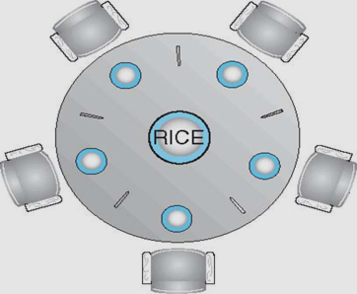
Dining-Philosophers Problem
Philosophers spend their lives alternating thinking and eating
Don’t interact with their neighbors, occasionally try to pick up 2 chopsticks (one at a time) to eat from bowl
Need both to eat, then release both when done
In the case of 5 philosophers
Shared data
Bowl of rice (data set)
Semaphore chopstick [5]
initialized to 1

Slide 37
Dining-Philosophers Problem
The structure of Philosopher i:
do {
wait (chopstick[i] );
wait (chopStick[ (i + 1) % 5] );
// eat
signal (chopstick[i] );
signal (chopstick[ (i + 1) % 5] );
// think
} while (TRUE);
What is the problem with this algorithm?

Slide 38
Problems with Semaphores
Incorrect use of semaphore operations:
signal (mutex) …. wait (mutex)
wait (mutex) … wait (mutex)
Omitting of wait (mutex) or signal (mutex) (or both)
Deadlock and starvation are possible.

Slide 39
Monitors
A high-level abstraction that provides a convenient and effective mechanism for process synchronization
Abstract data type, internal variables only accessible by code within the procedure
Only one process may be active within the monitor at a time
monitor monitor-name
{
// shared variable declarations
procedure P1 (…) { …. }
procedure Pn (…) {……}
Initialization code (…) { … }
}
}

Slide 40
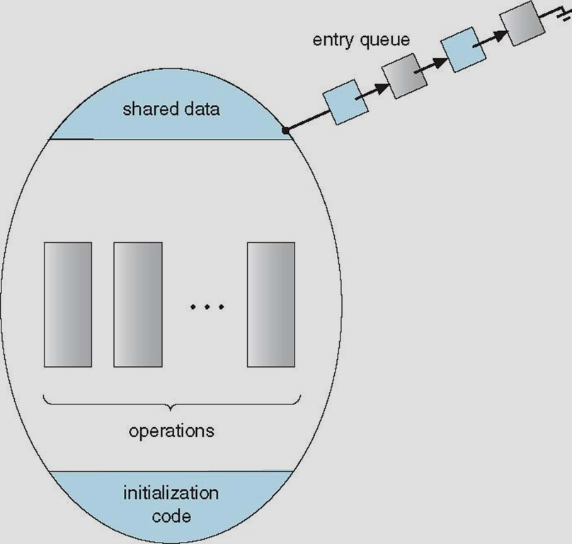
Monitors
Two operations are allowed on a condition variable:
x.wait() – a process that invokes the operation is suspended until x.signal()
x.signal() – resumes one of processes (if any) that invoked x.wait()
If no x.wait() on the variable, then it has no effect on the variable
Schematic view of a Monitor

Slide 41
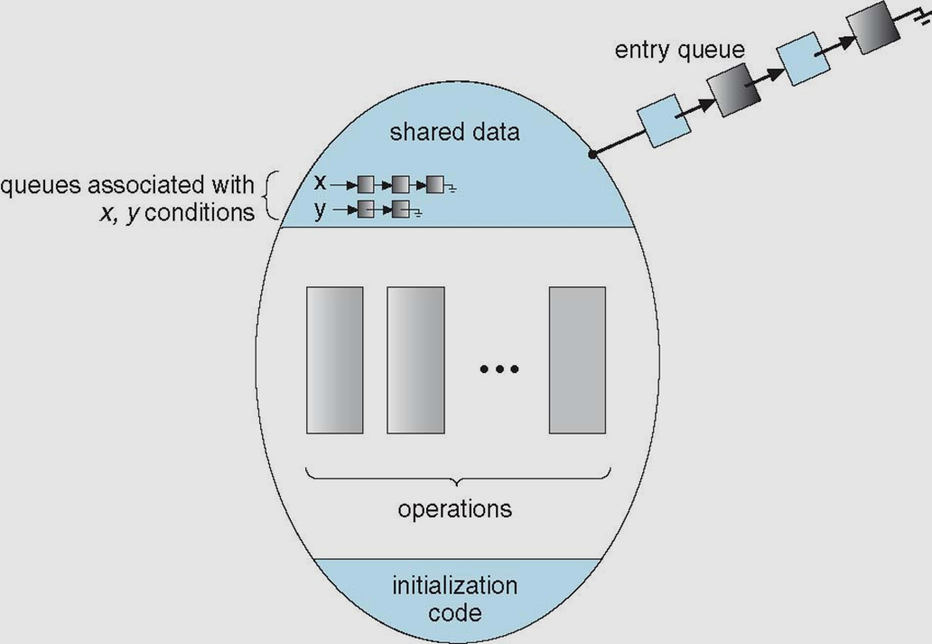
Monitor with Condition Variables

Slide 42
Condition Variables Choices
If process P invokes x.signal(), and process Q
is suspended in x.wait(), what should happen next?
Both Q and P cannot execute in parallel. If Q is resumed, then P must wait
Options include
Signal and wait – P waits until Q either leaves the monitor or it waits for another condition
Signal and continue – Q waits until P either leaves the monitor or it waits for another condition
Both have pros and cons – language implementer can decide
Monitors implemented in Concurrent Pascal compromise
P executing signal immediately leaves the monitor, Q is resumed
Implemented in other languages including Mesa, C#, Java

Slide 43
Monitor Solution - Dining Philosophers
monitor DiningPhilosophers
{
enum{ THINKING; HUNGRY, EATING) state [5] ;
condition self [5];
void pickup (int i) {
state[i] = HUNGRY;
test(i);
if (state[i] != EATING) self[i].wait;
}
void putdown (int i) {
state[i] = THINKING;
// test left and right neighbors
test((i + 4) % 5);
test((i + 1) % 5);
}

Slide 44
Monitor Solution - Dining Philosophers
void test (int i) {
if ((state[(i + 4) % 5] != EATING) &&
(state[i] == HUNGRY) &&
(state[(i + 1) % 5] != EATING) ) {
state[i] = EATING ;
self[i].signal () ;
}
}
initialization_code() {
for (int i = 0; i < 5; i++)
state[i] = THINKING;
}
}

Slide 45
Monitor Solution - Dining Philosophers
Each philosopher i invokes the operations pickup() and putdown() in the following sequence:
DiningPhilosophers.pickup(i);
{
EAT
}
DiningPhilosophers.putdown(i);
No deadlock, but starvation is possible

